Slide 1
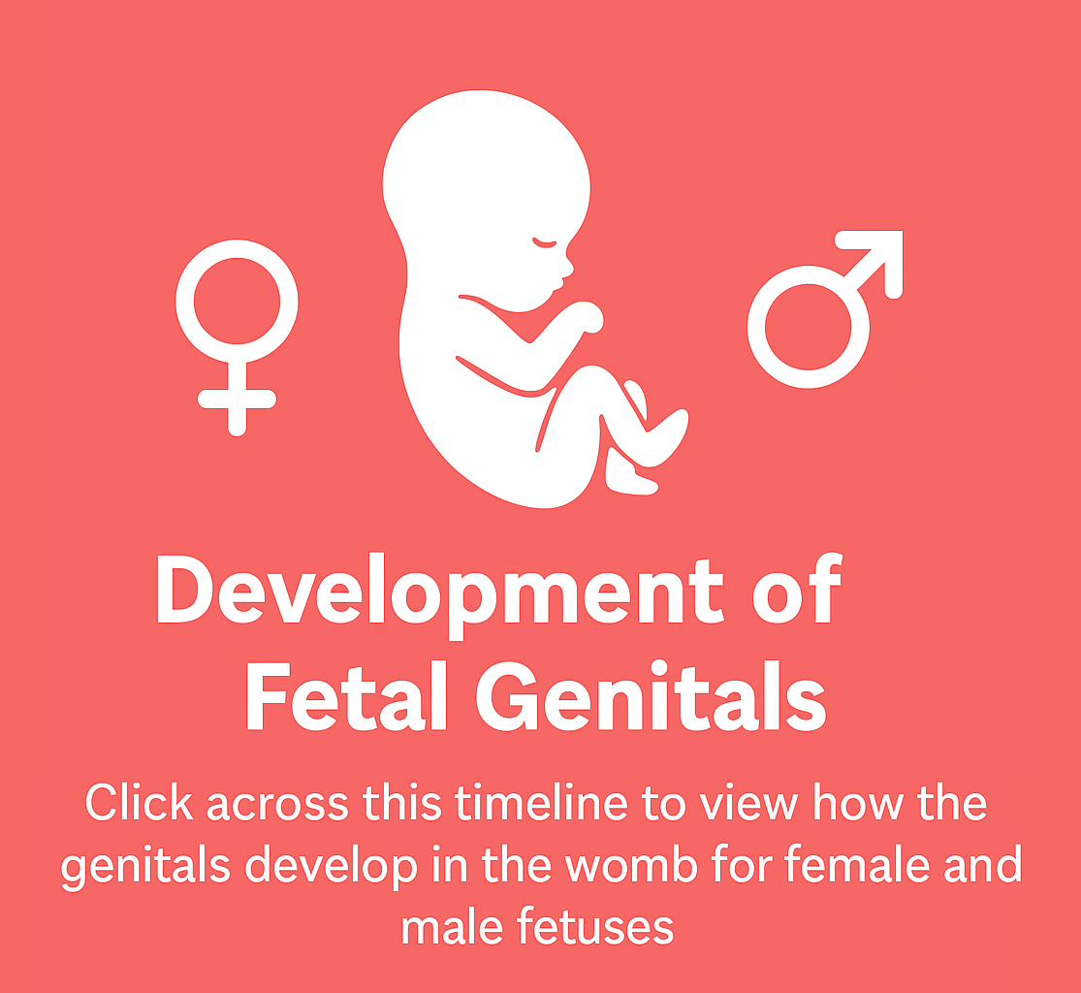

Slide 2
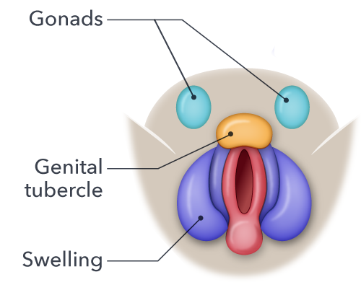
At 6 weeks of gestation, all fetuses have the same "protogenitals," which resemble neither female nor male genitals. These include the gonads, tubercle and swelling.

Slide 3
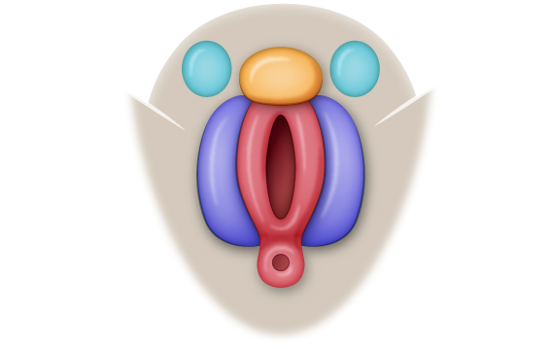
At 12 weeks, the protogenitals have developed about halfway to their fully developed form. In this case, the swelling has largely remained in place, with a hole forming between them. What sex do you think this fetus is?

Slide 4
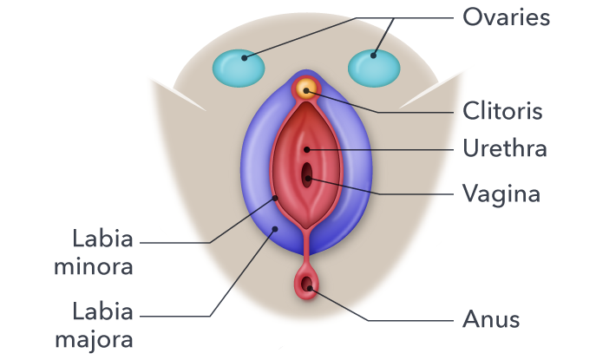
At 20 weeks, the fetus has developed fully functioning genitals. You can now see this is a female fetus, with a clitoris, labia and ovaries.

Slide 5
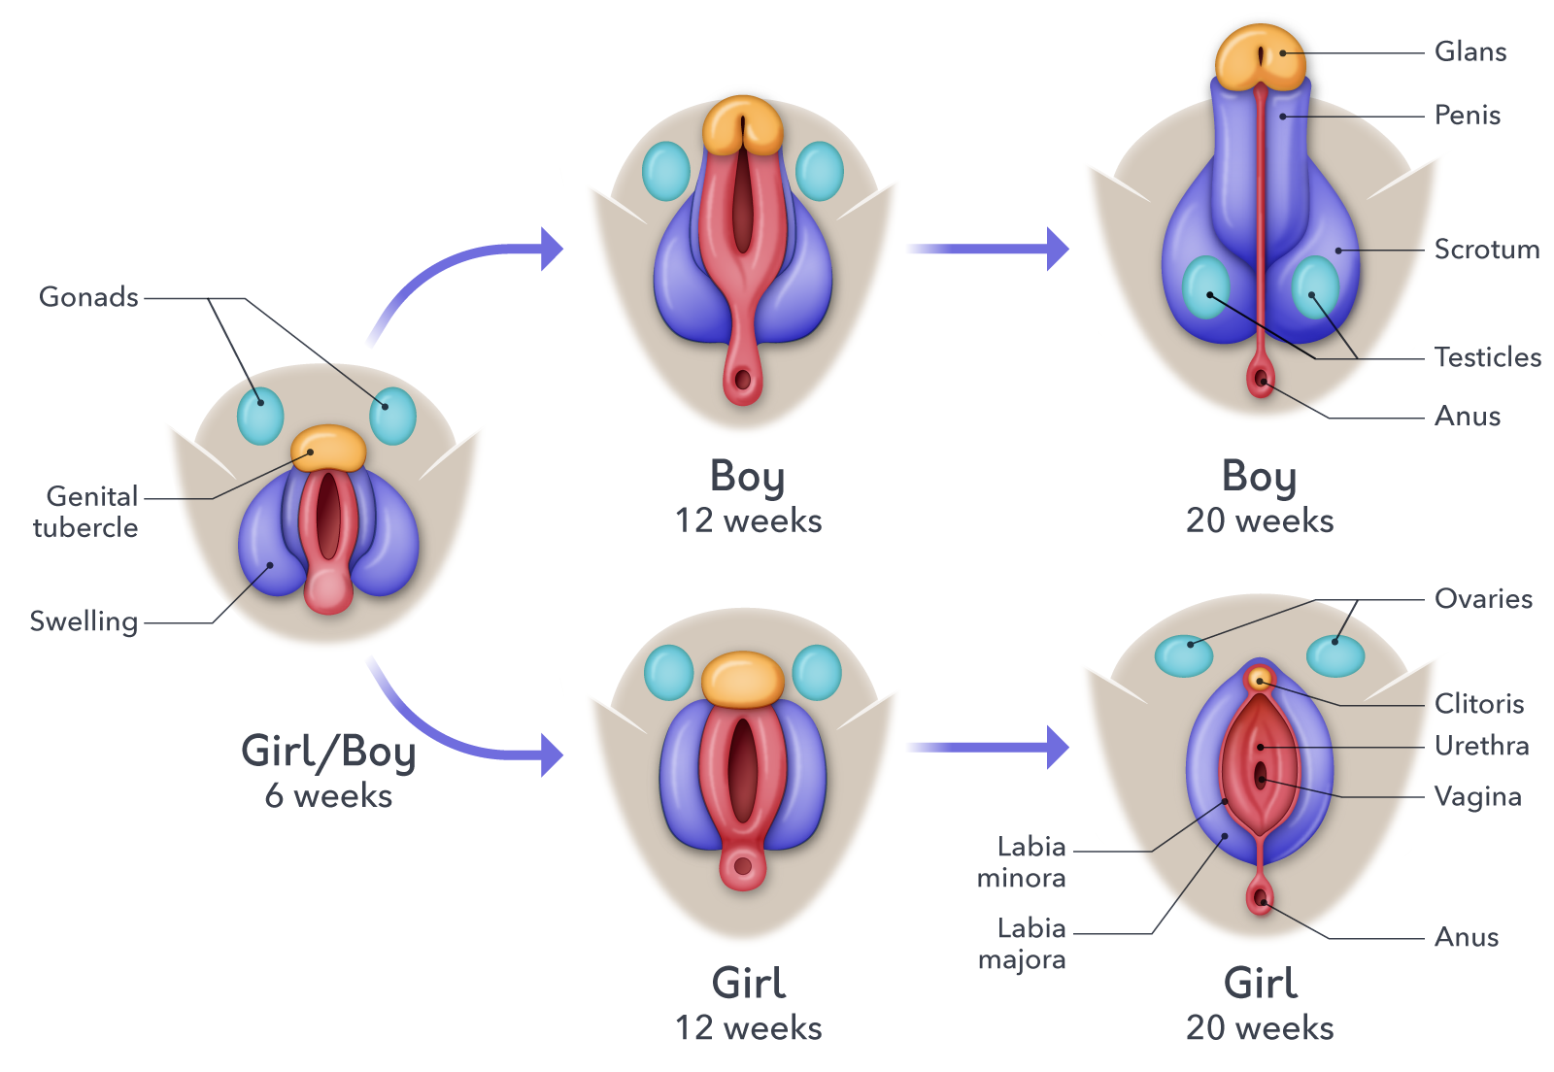
This shows the differences in the development of female and male genitals.

